Slide 1

Enhancing Response in HER2-Positive Breast Cancer
Sara A Hurvitz, MD, FACP
University of California, Los Angeles Los Angeles, California, United States

Slide 2
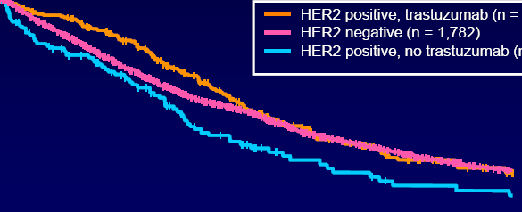
Trastuzumab Has Changed the Natural History of HER2-Positive Breast Cancer
Patients with HER2-positive metastatic breast cancer (MBC) now have comparable outcomes with HER2-negative MBC
Probability of Survival, %
100
80
60
40
20
0
HER2 positive, TRAS (n = 191)
HER2 negative (n = 1782)
HER2 positive, no TRAS (n = 118)
0 12 24 36 48 60
TRAS, trastuzumab
Dawood S, et al. J Clin Oncol. 2010;28(1):92-98.

Slide 3
HER2-Positive Breast Cancer: Major Clinical Advances
Phase III
of pertuzumab
TRAS
approved (advanced)
Three large
adjuvant trials
of TRAS reported
Lapatinib
approved
(advanced)
Phase II
randomized
trial of T-DM1
Pertuzumab approved (advanced)
1998
1999
2000
2001
2002
2003
2004
2005
2006
2007
2008
2009
2010
2011
2012
2013
First preoperative
trials reported, paving the way for use of TRAS in early-stage disease
TRAS
approved (adjuvant)
Initial trials
of T-DM1,
pertuzumab,
neratinib, afatinib
Preop
trials of
dual blockade
T-DM1 phase 3 reported
T-DM1 approved
(advanced)
BC, breast cancer; T-DM1, trastuzumab emtansine
Krop I, et al. Cancer Res. 2011;71(24): Abstract ES1-3.

Slide 4
Case Presentation
Linda is a 43-year-old woman who was referred for treatment of newly diagnosed breast cancer after presenting to her primary physician complaining of cough and dyspnea
Imaging showed 4 cm mass in the right breast, right axillary/subpectoral/mediastinal lymphadenopathy, moderate right pleural effusion, pleural thickening on the right side, and multiple peri centimeter nodules in both lungs

Slide 5
Case Presentation
Biopsy of the breast revealed an invasive ductal carcinoma, high grade, estrogen receptor (ER) positive (50%, 2+) progesterone receptor (PR) negative, HER2 3-positive breast cancer
Pleural fluid cytology: Positive for metastatic breast cancer
What first line regimen would you offer this patient?

Slide 6
Review of First-Line Options

Slide 7
Chemotherapy Plus Trastuzumab in Metastatic Disease
 | Slamon, et al n = 469 |  |  | Marty, et al n = 186
Treatment arms | AC or PAC* vs AC or PAC →TRAS |  |  | DOC vs DOC →TRAS†
Time to disease progression (months) | 4.6 | 7.4 | P value | 6.1 | 11.7 | P value
 |  |  | <.001 |  |  | .0001
Response rate | 32% | 50% | <.001 | 34% | 61% | .0002
Median OS (months) | 20 | 25 | .046 | 23 | 31 | .0325
AC, anthracycline, cyclophosphamide; PAC, paclitaxel; DOC, docetaxel; OS, overall survival
Hudis CA. N Engl J Med. 2007;357(1):39-51. Slamon DJ, et al. N Engl J Med. 2001;344:783-792. Marty M, et al. J Clin Oncol. 2005;23(19):4265-4274.
Notes:
Overall response rates of 11-26% have been reported using trastuzumab as a monotherapy agent in the metastatic breast cancer setting. However, trastuzumab is often used today combination with a chemotherapy regimen.
Slamon et al
The definite benefit of adding trastuzumab to chemotherapy vas demonstrated in a phase III trial of 469 patients with HER2 positive metastatic disease receiving AC (doxorubicin 60 mg/m² or epirubicin 5 mg/m²) plus cyclophosphamide 600 mg/m² or paclitaxel 175 mg/m² with or without trastuzumab x 6 cycles as first line therapy. Patients with disease progression were able to participate in an open-lapel study of trastuzumab administered alone or in combination with other therapy.
The primary endpoint, median time to disease progression (shown) was 7.4 months for combination with herceptin vs 4.6 months for chemotherapy alone. The difference was evident in both subgroups (AC + trastuzumab) 7.8 months vs 6.1 months (AC alone) P < 0.001 and (paclitaxel + trastuzumab) 6.9 months vs 3.0 months (paclitaxel alone) P < 0.001.
Overall response rate (CR+PR) was a secondary endpoint that also achieved statistical significance for chemotherapy with trastuzumab vs chemotherapy alone. The difference was again evident in both subgroups: AC + trastuzumab, 56% vs 42% (AC alone), P= 0.02 and paclitaxel + trastuzumab, 41% vs 17% (paclitaxel alone), P < 0.001.
Finally, overall median survival was also longer in the combination of chemotherapy with trastuzumab vs chemotherapy alone (shown above). Subgroup: AC + trastuzumab, 26.8 vs 21.4 months (AC alone), P =0.16 and paclitaxel + trastuzumab, 22.1 months vs 18.4 months (paclitaxel alone), P =0.17.
Trastuzumab therapy in combination with chemotherapy reduced the relative risk of death by 20% at a median follow-up of 30 months. Cardiac dysfunction was a significant finding and will be discussed, in detail, later in the presentation.
Conclusion: As compared with standard of care chemotherapy, the addition of trastuzumab resulted in longer time to disease progression, longer duration of response, and improved overall survival.
Marty et al
The known clinical activity of trastuzumab plus paclitaxel, the clinical use of docetaxel in the setting of metastatic breast cancer, and favorable results of phase II trials of trastuzumab plus docetaxel provided rational for investigating the ORR of trastuzumab plus docetaxel vs docetaxel alone.
Marty et al conducted a phase II open label, randomized, multicenter comparative trial comparing docetaxel 100 mg/m² IV q 3 weeks x 6 cycles with or without trastuzumab.
Docetaxel + trastuzumab has a statistically significant increase in TTP, RR and OS as listed.
Two patients, both having received adjuvant anthracyclines developed CHF.
Randomized trials are now being conducted to investigate the potential benefit of adding in a third agent such as capecitabine (MO16419 trial) or carboplatin (BCIRG 007).

Slide 8
Hormonal Therapy in HER2-Positive Metastatic Breast Cancer
Regimen | ORR, % | Median PFS, months
Trastuzumab (N = 114; HER2 positive, n = 79)¹ | 26 | 3.5-3.8
Anastrozole/trastuzumab (n = 103)² | 20 | 4.8
Anastrozole (n = 104)² | 7 | 2.4
Lapatinib/letrozole (n = 642)³ | 28 | 8.2
Letrozole (n = 644)³ | 15 | 3.0
Lapatinib (N = 138)⁴ | 24 | NA
ORR, overall response rate; PFS, progression-free survival
1. Vogel C, et al. J Clin Oncol. 2002;20(3):719-726. 2. Kaufman B, et al. J Clin Oncol. 2009;27(33):5529-5537. 3. Johnston S, et al. J Clin Oncol. 2009;27(33):5538-5546. 4. Gomez HL, et al. J Clin Oncol. 2008;26:2999-3005.
Notes:
8
NA, not available; ORR, overall response rate; PFS, progression-free survival.
This slide summarizes 3 different studies relating to the use of single agent HER2-targeted therapy or the combination of an aromatase inhibitor plus a HER2-targeted agent or an aromatase inhibitor itself.
On the first line is data from a single-arm study looking at the first-line objective response rates and progression-free survival with the use of trastuzumab for HER2-positive metastatic breast cancer. And, as you can see, in this setting, the use of single-agent trastuzumab yielded an objective response rate of 26% and a progression-free survival of 3.5-3.8 months.
The TANDEM study is shown in rows 2 and 3. This was a study which enrolled patients with HER2-positive first-line metastatic breast cancer. Patients received anastrozole or anastrozole plus trastuzumab, and in this study, the patients who received the combination had a higher objective response rate of 20% and an improved progression-free survival of 4.8 months.
The bottom 2 rows, are lapatinib plus letrozole vs letrozole alone. This was a large, randomized study, and in this study, the use of the aromatase inhibitor plus lapatinib yielded an objective response rate of 28% and a progression-free survival of 8.2 months. Lapatinib single agent in HER2-positive metastatic breast cancer in the frontline setting is shown in the last row there and shows that about 24% of patients who are treated with single-agent lapatinib in the frontline setting are going to be able to have an objective response.
These data underscore the activity of single-agent HER2-targeted agents and give an idea of what the addition of an aromatase inhibitor may add to this regimen.

Slide 9
MOA of Trastuzumab vs Pertuzumab^{1,2}
Inhibition through direct antibody binding
Inhibition through dimerization inhibition
TRAS does not bind or sterically hinder HER2 dimerization domain
Pertuzumab blocks dimerization of HER2 with HER3
Modeling studies suggest that the colocalization of both HER2 mABs triggers formation of additional contacts of TRAS with HER2 (but only in presence of pertuzumab)
I
I
Pertuzumab
II
Dimerization
II
III
domain
III
Dimerization
domain
Trastuzumab
IV
IV
Tyrosine kinase
Tyrosine kinase
MOA, mechanism of action; mABs, monoclonal antibodies
1. Reprinted from Baselga J, et al. Nat Rev Cancer. 2009;9:463-475. 2. Fuentes G, et al. Breast Cancer Res. 2011;13:R54.
Notes:
Pertuzumab (Perjeta™, Genentech) is a recombinant humanized monoclonal antibody believed to interact with the extracellular dimerization domain (II) on HER2.¹
In contrast, TRAS (Herceptin® Genentech) is believed to interact with an extracellular domain (IV) on HER2 that is distinct from that involved in HER dimerization.^{1,2}
HER2 homodimers activate the Ras-Raf pathway, and it has been shown that the monoclonal antibody trastuzumab preferentially inhibits these HER2 homodimers, which has implications for both efficacy and resistance.³
Modelling studies suggest that the colocalization of both HER2 monoclonal antibodies (mABs) triggers the formation of additional points of contact of TRAS with HER2, but that this only occurs in the presence of pertuzumab.¹
References
Fuentes G, et al. Breast Cancer Res. 2011;13:R54.
Vu T, Claret FX. Front Oncol. 2012;2:1-6.
Ghosh R, et al. Cancer Res. 2011;71:1871-1882.

Slide 10
CLEOPATRA: Study Design
Primary endpoint: PFS (independently assessed)
Secondary endpoints: PFS (investigator assessment), ORR, OS, Safety
Trastuzumab 6 mg/kg q3w* +
Docetaxel 75-100 mg/m² q3w† +
Pertuzumab (PTZ) 420 mg q3w‡
(n = 402)
Women with previously untreated, HER2-positive locally recurrent/metastatic breast cancer
(N = 808)
Treatment until disease progression or unacceptable toxicity
Trastuzumab 6 mg/kg q3w* +
Docetaxel 75-100 mg/m² q3w† +
Placebo q3w
(n = 406)
*Trastuzumab 8 mg/kg loading dose given
†Minimum of 6 docetaxel cycles recommended; <6 cycles permitted for unacceptable toxicity or progressive disease (PD)
‡Pertuzumab 840 mg loading dose given
Baselga J, et al. Presented at: 34th Annual San Antonio Breast Cancer Symposium; December 6-10, 2011; San Antonio, Texas. Abstract S5-5.
Notes:
PD, progressive disease; PFS, progression-free survival; ORR, overall response rate; OS, overall survival.
Kathy D. Miller, MD:
The results from the CLEOPATRA study was one of the most exciting reports at the 2011 meeting, and these data have recently been published in the New England Journal of Medicine.^{[1]} The CLEOPATRA trial was an international, multicenter, double-blind, placebo-controlled randomized phase III trial investigating the addition of pertuzumab to first-line trastuzumab plus docetaxel in patients with HER2-positive locally recurrent or metastatic breast cancer.
William J. Gradishar, MD, FACP:
The rationale behind the design of this study may not be completely understood. HER2 is part of the family of epidermal growth factor receptors, which dimerize on ligand binding, resulting in the activation of signal transduction pathways that lead to cell growth and differentiation. HER2 is the preferential binding partner for other members of the family (ie, HER-1, -3, and -4). The HER2-targeted humanized monoclonal antibodies, trastuzumab and pertuzumab, have complementary mechanisms of action. Trastuzumab binds to the HER2 extracellular domain IV and inhibits ligand-independent HER2 signaling. Pertuzumab also binds to the HER2 extracellular domain, but at a different epitope (domain II), and on binding prevents HER2 dimerization with other ligand-activated HER receptors. Because these agents have complementary mechanisms of action, it was hypothesized that combination therapy would be associated with a clinical synergy. Therefore, to test this hypothesis, Baselga and colleagues randomized 808 patients with previously untreated, HER2-positive locally recurrent/metastatic breast cancer to receive trastuzumab and docetaxel with or without pertuzumab.
Kathy D. Miller, MD:
Slightly less than 50% of the study population had received adjuvant or neoadjuvant chemotherapy, and only 10% had received previous trastuzumab therapy. Essentially, this was a population of patients that was naive to anti-HER2 therapy.
Reference
1. Baselga J, Cortés J, Kim SB, et al. Pertuzumab plus trastuzumab plus docetaxel for metastatic breast cancer. N Engl J Med. 2012;366:109-119.
10

Slide 11
CLEOPATRA: PFS Independent Assessment
months
months
Baselga J, et al. N Engl J Med. 2012;366(2):109-119. Swain S, et al. Lancet Oncol. 2013;14(6):461-471.

Slide 12
CLEOPATRA Overall Survival
100
1 year
94%
90
2 years
HR = 0.66
P = .0008
80
89%
81%
3 years
Overall Survival, %
70
66%
60
69%
50
40
50%
30
ORR
80.2%
69.3%
P = .001
20
PTZ + TRAS + DOC: 113 events; median not reached
Placebo + TRAS + DOC: 154 events; median 37.6 reached
10
0
0
5
10
15
20
25
30
35
40
45
50
55
Time, months
ESMO 2014 update on OS at 50 months median follow-up
PTZ + TRAS + DOC | Placebo + TRAS + DOC
56.5 months | 40.8 months | HR = 0.68, P = .0002
48 patients crossed over from placebo to PTZ arm after previous report of OS benefit
Long-term cardiac safety profile maintained
Swain S, et al. Ann Oncol. 2014;25(Suppl 4): Abstract 3500PR.

Slide 13
HR by ER/PR status
 | No of patients | HR (95%)
OS
All | 808 | 0.66 (0.52-0.84)
ER/PR-positive | 388 | 0.73 (0.50-1.06)
ER/PR-negative | 408 | 0.57 (0.41-0.79)
PFS
All | 808 | 0.69 (0.58-0.81)
ER/PR-positive | 388 | 0.76 (0.60-0.97)
ER/PR-negative | 408 | 0.62 (0.49-0.78)
Swain S, et al. Ann Oncol. 2014;25(Suppl 4): Abstract 3500PR.

Slide 14
Other Options on the Forefront for First-Line?

Slide 15

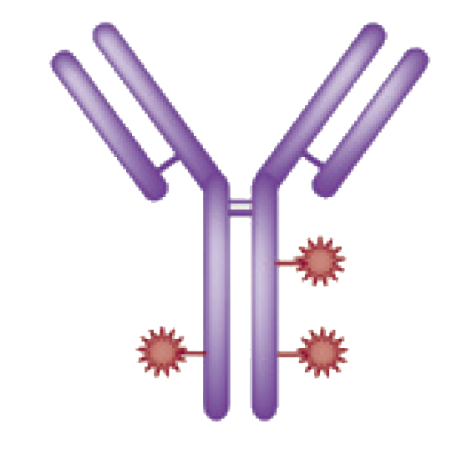




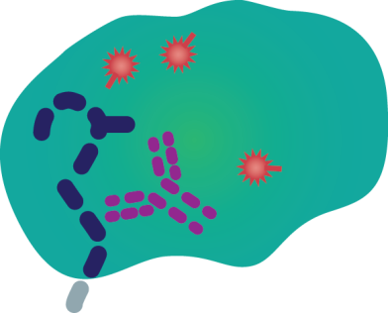
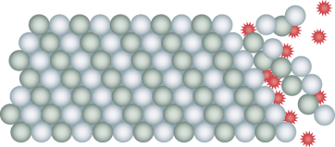


T-DM1: Mechanism of Action
HER2
T-DM1
Emtansine release
P
P
Inhibition of microtubule polymerization
P
Lysosome
Internalization
Nucleus
Adapted from LoRusso PM, et al. Clin Cancer Res. 2011;17(20):6437-6447.
Notes:
15
15

Slide 16
TDM4450 Study Design
HER2-positive, recurrent locally advanced breast cancer or MBC (N = 137)
Trastuzumab
8 mg/kg loading dose; 6 mg/kg q3w IV
+ Docetaxel
75 or 100 mg/m² q3w
(n = 70)
PDª
Crossover to
T-DM1
(optional)
1:1
T-DM1
3.6 mg/kg q3w IV
(n = 67)
PDª
Randomized, phase II, international, open-label study^{b}
Stratification factors: World region, prior adjuvant trastuzumab therapy, disease-free interval
Primary end points: PFS by investigator assessment, and safety
Data analyses were based on clinical data cut of Nov 15, 2010 prior to T-DM1 crossover
Key secondary end points: OS, ORR, DOR, CBR, and QOL
ªPatients were treated until PD or unacceptable toxicity
^{b}This was a hypothesis generating study; the final PFS analysis was to take place after 72 events had occurred
DOR, duration of response; CBR, clinical benefit rate; QoL, quality of life
Hurvitz SA, et al. J Clin Oncol. 2013;31(9):1157-1163.
Notes:
16
TDM4450g study design
Patient population : MBC patients with no prior 1st line treatment
Patients were HER2+ by local testing but central HER2 testing was not required for enrollment
Prospectively-designed central HER2 testing was performed for 61 patients in the trastuzumab + docetaxel arm and 61 patients in the T-DM1 arm.
Straight forward study design to test the hypothesis of the ADC vs standard of care first line therapy with docetaxel and trastuzumab
For the control arm, the investigators were given a choice of whether to use 75 mg/m² docetaxel or 100 mg/m² docetaxel (approximately 75% used 75 mg/²). Once assigned, no intrasubject dose escalation was allowed.
Cross-over to T-DM1 was optional (27 patients crossed over from the trastuzumab + docetaxel group to receive T-DM1 as second line treatment)
Patients continued on therapy until either PD or toxicity requiring change of therapy, as deemed necessary by investigator or per study guidelines
Primary endpoint: PFS by investigator and Secondary Endpoints: OS, ORR, DOR, CBR and QOL by Fact B and TOI; OS and QOL data will not be presented here (OS data cut will be available early 2012; QOL data to be presented at a future congress)
CBR, clinical benefit rate; DOR, duration of response; MBC, metastatic breast cancer; ORR; overall response rate; OS, overall survival; PFS, progression-free survival; q3w, every 3 weeks; QOL, quality of life.

Slide 17
TDM4450 PFS by Investigator: Randomized Patients
Median PFS, months | Hazard ratio | 95% CI | Log-rank P value
9.2 14.2 | 0.594 | 0.364- 0.968 | 0353
1.0
0.8
0.6
0.4
0.2
0.0
TRAS+ DOC (n = 70)
T-DM1 (n = 67)
Proportion Progression Free
0 2 4 6 8 10 12 14 16 18 20
Number of patients at risk
70 66 63 53 43 27 12 4 2 2 0
67 60 51 46 42 35 22 15 6 3 0
Time, months
TRAS + DOC
T-DM1
Hazard ratio and log-rank P value were from stratified analysis
Hurvitz SA, et al. J Clin Oncol. 2013;31(9):1157-1163.
Notes:
Primary endpoint of PFS by investigator is presented here as shown with this Kaplan Meier curve for PFS
Median PFS for T-DM1 was 14.2 months as compared to 9.2 months for control arm.
PFS difference between T-DM1 and control arm was statistically significant with a HR of 0.594 and P-value of 0.0353
The following is for discussion in case of questions only:
The early part of the curve probably is due to random chance and small sample size in the study; poor prognostic factors (such as higher tumor burden) might be a contributing factor. But, we won't find the answer from this study and we have to wait for confirmatory results.
The T-DM1 and control arms separate at 6 months and although there is no statistically meaningful difference in the early part of the curve with too few events, a covariate analysis may be conducted to look for any possible explanations for the trend
This will only be hypothesis-generating without conclusive data since there are too few numbers
Possible hypotheses have been suggested by this data including:
Is this secondary to docetaxel being stopped at 6 cycles? This is not supported by data since a significant number of patients had received more than 8 cycles of docetaxel at the data cut: 52 pts on docetaxel at Cycle 8 at data cut and 46 patients had 9 cycles of docetaxel, 31 patients had 12 cycles at data cut)
Were there more patients in the T-DM1 arm that were not HER2-positive centrally confirmed among early progressors? Other biological risk factors imbalanced among early progressors?
HER2-positive: 29/51 in trastuzumab + docetaxel arm vs 35/52 in T-DM1 arm
HER2-normal: 7/9 in trastuzumab + docetaxel arm vs 5/9 in T-DM1 arm
More dose reductions in T-DM1 arm early on?
Tumor assessment occurred every 9 weeks
This study is representative of “real world” practice by using investigator-assessed PFS
CI, confidence interval; T, trastuzumab; D, docetaxel.

Slide 18
First-Line mBC Phase III MARIANNE Study: BO22589/TDM4788g
n = 1092
FPI July 6, 2010
Arm A
Trastuzumab + taxane (until PD)
N = 364
Patients stratified by:
World region
Neo/Adjuvant therapy (Y/N)
Trastuzumab and/or lapatinib based therapy (Y/N)
Visceral disease (Y/N)
Arm B
T-DM1 + pertuzumab (until PD)
N = 364
Arm C
T-DM1 + pertuzumab placebo (until PD)
N = 364
Patients with HER2 positive progressive or recurrent locally advanced breast cancer or previously untreated metastatic breast cancer
Primary endpoints: PFS as assessed by IRF; Safety
Secondary endpoints: OS; PFS by investigator; PRO analyses; Biomarkers
Non-inferiority followed by Superiority analysis between each of the experimental arms and the control arm
Interim futility analysis: Option to drop experimental arm
Ellis PA, et al. J Clin Oncol. 2011;29(15S): Abstract TPS102.

Slide 19
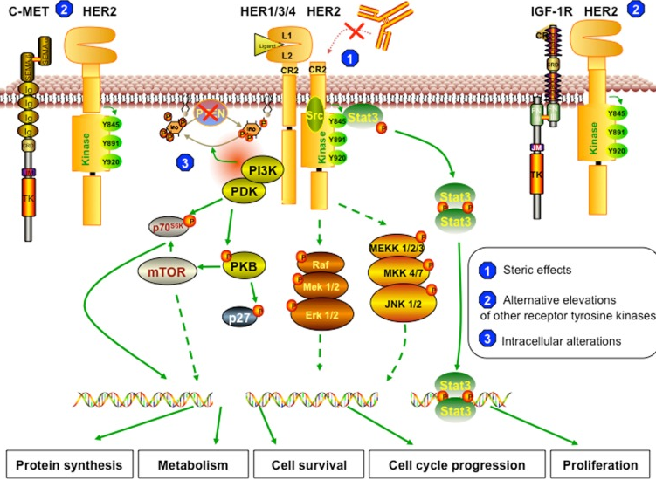
Mechanisms of Resistance
Activated PI3K-AKT-mTOR pathway
Loss PTEN
Activating mutation PI3K
Activation mutation AKT
Vu T, et al. Front Oncol. 2012;2:62.

Slide 20
BOLERO-1/TRIO 019: Trial Design
N = 719
Locally advanced or metastatic HER2+ breast cancer
No prior therapy for advanced or metastatic disease (except endocrine therapy)
Prior (neo)adjuvant TRAS and/or chemotherapy allowed¹
Measurable disease or presence of bone lesions (lytic or mixed)
Everolimus (10 mg PO daily) + Paclitaxel² + Trastuzumab³
Randomized 2:1
Placebo +
Paclitaxel² + Trastuzumab³
Stratification factors:
Prior neo/adjuvant TRAS
Visceral metastases
Therapy until disease progression or intolerable toxicity⁴
Endpoints
Primary: PFS (investigator-assessed)
Overall population and
HR⁻ subpopulation
Secondary:
OS, ORR, CBR, Time to response, Safety, Duration of response
¹Discontinued > 12 mo before randomization;
²Paclitaxel: 80 mg/m² weekly;
³Trastuzumab: 4 mg/kg loading dose on day 1 at cycle 1 followed by 2 mg/kg weekly doses
⁴Patients could discontinue any study treatment due to AEs; other study treatments continued until disease progression or intolerable toxicity
ABC, advanced breast cancer; CBR, clnical benefit rate; ORR, overall response rate; OS, overall survival; PFS, progression free survival.
Hurvitz SA, et al. Presented at: 2014 San Antonio Breast Cancer Symposium; December 9-13, 2014; San Antonio, Texas. Abstract S6-01.
Notes:
20

Slide 21
BOLERO-1/TRIO 019: PFS by Investigator Assessment (Full Study Population)
100%
Hazard Ratio = 0.89; 95 % CI [0.73, 1.08]
Log rank p value = 0.1166
80%
Median PFS
Everolimus: 14.95 months; 95% CI [14.55, 17.91]
Placebo: 14.49 months; 95% CI [12.29, 17.08]
60%
Probability (%)
40%
20%
0%
0
2
4
6
8
10
12
14
16
18
20
22
24
26
28
30
32
34
36
38
40
42
44
46
48
50
52
54
56
Time (months)
No. of patients still at risk
Everolimus
480
416
365
324
289
260
217
178
151
130
122
107
94
80
72
63
58
48
42
35
26
21
17
13
10
5
3
3
0
Placebo
239
221
199
166
144
123
106
91
80
69
53
47
43
38
36
36
31
24
17
15
12
9
7
6
4
3
1
1
0
- One-sided p-value is obtained from the log-rank test stratified by prior use of trastuzumab (Y/N) and Visceral metastasis (Y/N) from IWRS.
Final PFS analysis was based on 425 PFS events observed in the full population
Hurvitz SA, et al. Presented at: 2014 San Antonio Breast Cancer Symposium; December 9-13, 2014; San Antonio, Texas. Abstract S6-01.

Slide 22
BOLERO-1/TRIO 019: PFS by Investigator Assessment (HR− Subpopulation)
100%
Hazard Ratio = 0.66; 95 % CI [0.48, 0.91]
Log rank p value = 0.0049
80%
Median PFS
60%
Everolimus: 20.27 months; 95% CI [14.95,24.08]
Probability (%)
Placebo: 13.08 months; 95% CI [10.05,16.56]
40%
20%
0%
0
2
4
6
8
10
12
14
16
18
20
22
24
26
28
30
32
34
36
38
40
42
44
46
48
50
52
54
56
Time (months)
No. of patients still at risk
Everolimus
208
183
166
151
138
125
100
84
73
64
62
55
49
40
35
32
30
24
21
19
15
11
10
7
5
2
1
1
0
Placebo
103
96
83
68
58
49
43
34
32
28
24
21
20
19
19
19
17
13
7
6
5
4
2
1
1
0
0
0
0
- One-sided p-value is obtained from the log-rank test stratified by prior use of trastuzumab (Y/N) and Visceral metastasis (Y/N) from IWRS.
Sensitivity analysis without censoring patients at the start of new antineoplastic therapy:
Median PFS and 95% CIs
20.27 mo (14.82, 24.08) for EVE [n = 102]
12.88 mo (10.94, 16.56) for PBO [n = 68]
HR=0.66 [0.48, 0.9], p = 0.0043
Hurvitz SA, et al. Presented at: 2014 San Antonio Breast Cancer Symposium; December 9-13, 2014; San Antonio, Texas. Abstract S6-01.

Slide 23
BOLERO-1/TRIO 019: Most Frequent Adverse Events (Safety set) [> 25% in the EVE Arm]
AE/Grade, % | EVE + TRAS + PAC (N = 472) |  |  | PBO + TRAS + PAC (N = 238)
 | Any | Grade 3 | Grade 4 | Any | Grade 3 | Grade 4
Non-hematologic
Stomatitis | 67 | 13 | 0 | 32 | 1 | 0
Diarrhea | 57 | 9 | 0 | 47 | 4 | 0
Alopecia | 47 | <1 | 0 | 53 | 0 | 0
Rash | 40 | 1 | 0 | 21 | <1 | 0
Cough | 40 | <1 | 0 | 33 | 1 | 0
Pyrexia | 39 | 2 | 0 | 27 | 1 | 0
Fatigue | 35 | 5 | 0 | 36 | 3 | 0
Pneumonitis* | 16 | 4 | 1 | 4 | <1 | 0
Hematologic
Neutropenia | 38 | 21 | 4 | 25 | 11 | 4
Anemia | 31 | 9 | 1 | 16 | 3 | 0
 | Full Population |  | HR– subpopulation
Deaths, % | EVE + TRAS + PAC (N = 472) | PBO + TRAS + PAC (N = 238) | EVE + TRAS + PAC (N = 206) | PBO + TRAS + PAC (N = 103)
On-treatment deaths | 4.7 | 0.8 | 3.4 | 1.9
Due to disease progression | 1.1 | 0.8 | 0.5 | 1.9
Due to AE | 3.6 | 0 | 2.9 | 0
*AE of clinical importance
EVE, Everolimus; HR, hormone receptor; PAC, Paclitaxel; PBO, Placebo; TRAS, Trastuzumab.
Hurvitz SA, et al. Presented at: 2014 San Antonio Breast Cancer Symposium; December 9-13, 2014; San Antonio, Texas. Abstract S6-01.

Slide 24
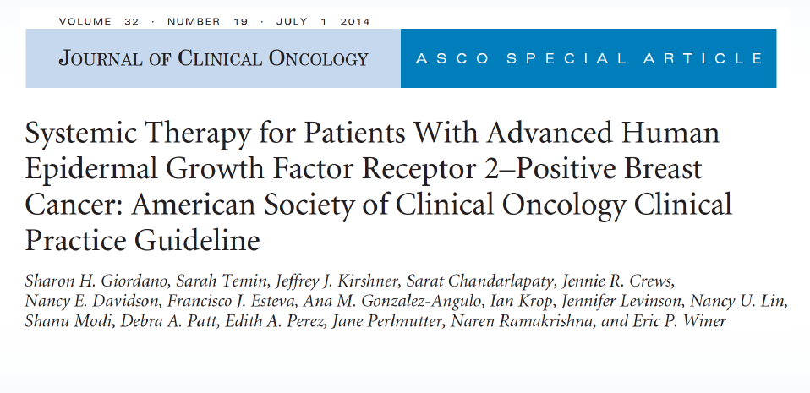
Summary: Optimal Choice First-Line Setting 2015
Clinicians should recommend combination of trastuzumab, pertuzumab and a taxane for first-line treatment, unless contraindication to taxane use
If ER+, can consider endocrine therapy + trastuzumab or lapatinib in selected cases
Giordano SH, et al. J Clin Oncol. 2014;32(19):2078-2099.

Slide 25
Case Continued
Linda receives first-line pertuzumab/ trastuzumab/docetaxel for 6 cycles
She has a complete response
She continues on pertuzumab/trastuzumab for 1 year when imaging reveals a new 2 cm lesion in the liver and several new subcentimeter nodules in the lungs
What second-line therapy do you recommend?

Slide 26
Case Continued
What second-line therapy do you recommend?
T-DM1
Resume docetaxel (or paclitaxel) and continue trastuzumab/pertuzumab
Continue trastuzumab/pertuzumab, add in tamoxifen
Vinorelbine, trastuzumab, everolimus
Lapatinib and capecitabine

Slide 27
Treatment Beyond Progression

Slide 28
We Do Know: Continued HER2 Blockade After Progression on Trastuzumab Is Beneficial
Author | Agents | N | TTP | PFS | OS
Von Minckwitz, et al | Capecitabine + trastuzumab vs capecitabine | 156 | 8.2 months vs 5.6 months, P = .03 | NR | 25.5 months vs 20.4 months P = .257
Geyer, et al | Capecitabine + lapatinib vs capecitabine | 324 | 8.4 months vs 4.4 months, P<.001 | 8.4 months vs 4.1 months, P<.001 | 19 months vs 16 months P = .206
Blackwell, et al | Lapatinib + trastuzumab vs lapatinib | 296 | NR | 12 weeks vs 8.1 weeks, P = .008 | 14 months vs 9.5 months, P = .026
TTP, time to progression
Blackwell K, et al. J Clin Oncol. 2012:30(21):2585-2592. Cameron D, et al. Oncologist. 2010:15(9):924-934. Geyer CE, et al. N Engl J Med. 2006;355(26):2733-2743. Von Minckwitz G, et al. J Clin Oncol. 2009:27(12):1999-2006.

Slide 29
EMILIA: T-DM1 Phase III Trial Design
Key endpoints
Primary: Progression-free survival (PFS, central assessment), safety, OS
Secondary: Objective response, duration of objective response, PFS (investigator review)
Stratification factors: World region, number of prior chemo regimens for ABC or unresectable LABC, presence of visceral disease
EMILIA
N = 978
Postmenopausal
ABC
Prior taxane and progression on TRAS
Cardiac ejection fraction ≥50%
ECOG PS ≤1
R
T-DM1 (3.6 mg/kg IV q3w)
Lapatinib + capecitabine (L: 1250 mg/d PO) (C: 1000 mg/m² PO BID, days 1-14q3w)
1:1
Estimated Study Completion Date: April 2014
Blackwell KL, et al. J Clin Oncol. 2012;20(suppl): Abstract LBA1. 2. Verma S, et al. N Engl J Med. 2012;367(12):183-1791.
Notes:
29
EMILIA: T-DM1 Phase 3 Trial
EMILIA is a phase 3, randomized, multicenter, international, two-arm, open-label clinical trial designed to compare the safety and efficacy of T-DM1 with that of capecitabine + lapatinib for HER2⁺ advanced BC following progression on TRAS. A total of 980 patients will be enrolled at more than 200 sites worldwide. Eligible patients will be randomized in a 1:1 ratio to either arm
Inclusion Criteria:
HER2 status must be prospectively, centrally tested and be HER2⁺ based on central laboratory assay results
Histologically or cytologically confirmed invasive breast cancer
Prior treatment for BC in the adjuvant, unresectable, locally advanced, or metastatic setting must include: a taxane, alone or in combination with another agent, and TRAS alone or in combination with another agent
Documented progression of incurable, unresectable, locally advanced or metastatic breast cancer, defined by the investigator
Measurable and/or nonmeasurable disease; patients with central nervous system (CNS)-only disease are excluded
Cardiac ejection fraction ≥ 50% by either ECHO or MUGA
Eastern Cooperative Oncology Group (ECOG) performance status of 0 or 1
Select Exclusion Criteria:
History of treatment with T-DM1
Prior treatment with lapatinib or capecitabine
Peripheral neuropathy of Grade ≥3 per National Cancer Institute Common Terminology Criteria for
Adverse Events (NCI CTCAE), Version 3.0
History of symptomatic congestive heart failure (CHF) or serious cardiac arrhythmia requiring treatment
History of myocardial infarction or unstable angina within 6 months of randomization
References:
Blackwell KL, et al. J Clin Oncol. 2012;30 (suppl; abstr LB1).
http://clinicaltrials.gov/ct2/show/NCT00829166 (Note that the target enrollment numbers are inconsistent between different sections of the clinicaltrials.gov entry; the target N = 980 was confirmed from the trial sponsor’s website [http://www.emiliaclinicaltrial.com/about/about_emilia_trials.php])

Slide 30

EMILIA: PFS by Independent Review
100
 | Median, months | No. events
CAP + L | 6.4 | 304
T-DM1 | 9.6 | 265
Stratified HR = 0.65 (95% CI, 0.55, 0.77) P<.001
80
60
Progression-Free Survival, %
40
20
0
0
2
4
6
8
10
12
14
16
18
20
22
24
26
28
30
T
ime, months
No. at risk by independent review:
CAP + L
496
404
310
176
129
73
53
35
25
14
9
8
5
1
0
0
T
-DM1
495
419
341
236
183
130
101
72
54
44
30
18
9
3
1
0
CAP, capecitabine; L, lapatinib
Verma S, et al. N Engl J Med. 2012;367(19):1783-1791.

Slide 31
EMILIA: OS
 | Median, months | No. events
CAP + L | 25.1 | 182
T-DM1 | 30.9 | 149
1.0
85.2% (95% CI, 82.0-88.5)
0.8
64.7% (95% CI, 59.3-70.2)
78.4% (95% CI, 74.6-82.3)
0.6
Overall Survival, %
0.4
51.8% (95% CI, 45.9-57.7)
0.2
Stratified HR: 0.68; (95% CI, 0.55-0.85); P<.001
Efficacy stopping boundary, P = .0037 HR: 0.73
0.0
0
2
4
6
8
10
12
14
16
18
20
22
24
26
28
30
32
34
36
No. at risk:
Time, months
CAP + L
496
471
453
435
403
368
297
240
204
159
133
1
10
86
63
45
27
17
7
4
T-DM1
495
485
474
457
439
418
349
293
242
197
164
136
11
1
86
62
38
28
13
5
Verma S, et al. N Engl J Med. 2012;367(19):1783-1791.

Slide 32
TH3RESA Study Schema
HER2-positive (central) advanced BCª
(N = 600)
≥2 prior HER2-directed therapies for advanced BC
Prior treatment with trastuzumab, lapatinib, and a taxane
T-DM1
3.6 mg/kg q3w IV
(n = 400)
PD
2
Treatment of physician’s choice (TPC)^{b}
(n = 200)
1
T-DM1^{c}
(optional crossover)
PD
Stratification factors: World region, number of prior regimens for advanced BC,^{d} presence of visceral disease
Co-primary endpoints: PFS by investigator and OS
Key secondary endpoints: ORR by investigator and safety
ª Advanced BC includes MBC and unresectable locally advanced/recurrent BC
^{b} TPC could have been single-agent chemotherapy, hormonal therapy, or HER2-directed therapy, or a combination of a HER2-directed therapy with a chemotherapy, hormonal therapy, or other HER2-directed therapy
^{c} First patient in: Sep 2011. Study amended Sep 2012 (following EMILIA 2nd interim OS results) to allow patients in the TPC arm to receive T-DM1 after documented PD
^{d} Excluding single-agent hormonal therapy
BC, breast cancer; IV, intravenous; ORR, objective response rate; PD, progressive disease; q3w, every 3 weeks
Krop IE, et al. Lancet Oncol. 2014;15(7):689-699.

Slide 33
TH3RESA: PFS (Investigator Assessment)
Stratified HR 0.528 (95% CI 0.422-0.661); P<.0001
Unstratified HR* 0.521 (95% CI 0.418-0.648); P<.0001
 | Physician’s choice (n = 198) | Trastuzumab emtansine (n = 404)
Median PFS (95% CI), months | 3.3 (2.89-4.14) | 6.2 (5.59-6.87)
Events | 129 | 219
Progression-Free Survival
100
80
60
Physician’s choice
Trastuzumab emtasine
40
20
0
0
2
4
6
8
10
12
14
Krop IE, et al. Lancet Oncol. 2014;15(7):689-699.

Slide 34
Physician’s choice
Trastuzumab emtasine
TH3RESA Overall Survival
100
Overall Survival, %
80
Stratified HR 0.552 (95% CI 0.369-0.826); P<.0034
Efficacy stopping boundary; HR 0.370; P<.0000016
Unstratified HR* 0.570 (95% CI 0.386-0.840); P<.0040
60
 | Physician’s choice (n = 198) | Trastuzumab emtansine (n = 404)
Median OS (95% CI), months | 14.9 (11.27-NE) | NE
Events | 44 | 61
40
20
0
0
2
4
6
8
10
12
14
16
Months since randomization
Number at risk
Physician’s choice
Trastuzumab emtansine
198
404
169
381
125
316
80
207
51
137
30
65
9
30
3
7
0
0
Krop IE, et al. Lancet Oncol. 2014;15(7):689-699.
Notes:
this result was not statistically significant, because it did not cross the prespecified O'Brien-Fleming stopping boundary (HR 0·370), which being more stringent at earlier analyses would have required a p value of less than 0·0000016.

Slide 35
If a patient’s HER2+ ABC has progressed during or after first-line HER2-targeted therapy, T-DM1 as second-line therapy should be recommended
If a patient finished trastuzumab based adjuvant treatment in ≤12 months before recurrence, second-line HER2-targeted therapy should be recommended
Giordano SH, et al. J Clin Oncol. 2014;32(19):2078-2099.

Slide 36
BOLERO-3 Study Design
Phase III Study
N = 569
Locally advanced or metastatic HER2+ breast cancer
Prior taxane required
Treatment Groups
Follow up/survival
Everolimus (5 mg PO daily) +
Vinorelbine (25 mg/m² weekly) +
Trastuzumab (2mg/kg weekly†)
(n = 284)
Key Endpoints
Primary: PFS
Secondary: OS, ORR, time to deterioration of ECOG PS, safety, DoR, CBR, QoL
R
1:1
Placebo (PO daily) +
Vinorelbine (25 mg/m² weekly) +
Trastuzumab (2mg/kg weekly†)
(n = 285)
Therapy until PD or intolerable toxicity
Stratification by prior lapatinib use (yes/no)
*Resistance to prior trastuzumab required
†Following a 4-mg/kg loading dose on day 1, cycle 1
PO, oral
O’Regan R, et al. J Clin Oncol. 2013;31(Suppl): Abstract 505.
Notes:
O’Regan R, Ozguroglu M, Andre F, et al. Phase III, randomized, double-blind, placebo-controlled multicenter trial of daily everolimus plus weekly trastuzumab and vinorelbine in trastuzumab-resistant, advanced breast cancer (BOLERO-3). Abstract 505.

Slide 37
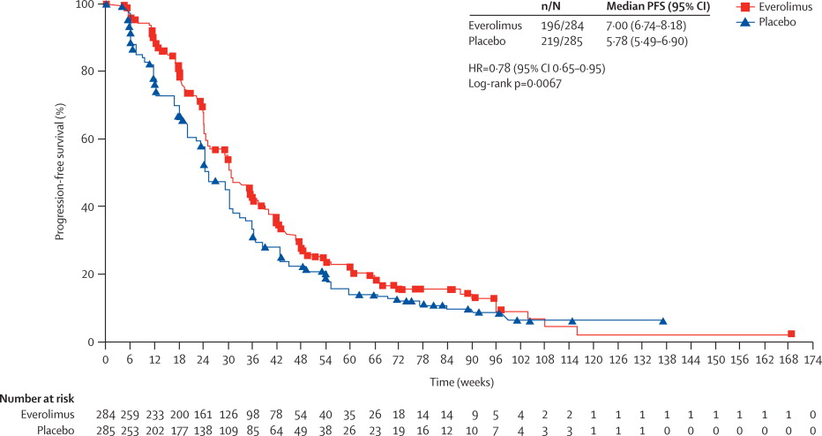
BOLERO-3 Improved locally assessed PFS with everolimus
Andre F, et al. Lancet Oncol. 2014:15(8):e304-e305.
Notes:
O’Regan R, Ozguroglu M, Andre F, et al. Phase III, randomized, double-blind, placebo-controlled multicenter trial of daily everolimus plus weekly trastuzumab and vinorelbine in trastuzumab-resistant, advanced breast cancer (BOLERO-3). Abstract 505.

Slide 38
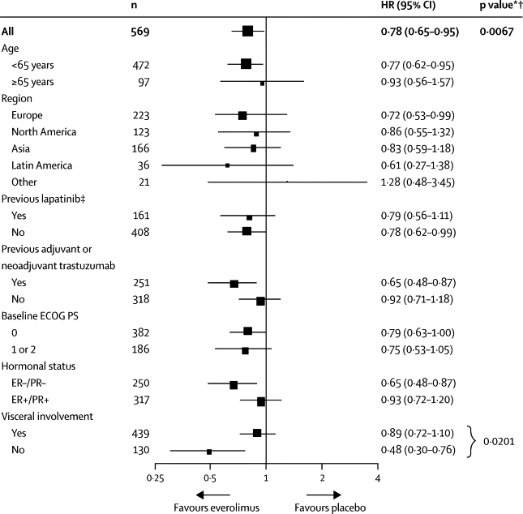
BOLERO-3 PFS Subgroup Analysis
Andre F, et al. Lancet Oncol. 2014:15(8):e304-e305.
Notes:
O’Regan R, Ozguroglu M, Andre F, et al. Phase III, randomized, double-blind, placebo-controlled multicenter trial of daily everolimus plus weekly trastuzumab and vinorelbine in trastuzumab-resistant, advanced breast cancer (BOLERO-3). Abstract 505.

Slide 39
Current Approach to HER2+ MBC
First line: Pertuzumab-Trastuzumab-Taxane
Future: T-DM1+pertuzumab?
Second line: T-DM1
Third line: Many options…optimal timing unknown
Lapatinib-trastuzumab
Lapatinib-capecitabine
Trastuzumab-other chemo

Slide 40
HER2-Targeted Therapies Under Evaluation
MM-302 (HER2 targeted pegylated liposomal doxorubicin using anti-HER2 antibody)
Neratinib (irreversible pan-HER inhibitor)
CDK4/6 inhibitors
PI3K pathway inhibition + HER2-blockade in HR-/HER2+?
PI3K pathway inhibition + HER2-blockade + endocrine tx in HR+/HER2+?
Vaccines

